Slide 1

Student Details
Name:- Akash Saha
Skill build email id:-sahaakash8432@gmail.com
Organization Name:- DGT
Contact no:- 6294058427
Internship Topic:- Data Analytics
Project Name:- Superstore Data analysis

Slide 2
Superstore Data Analysis
In this project I’m analyzing a super store data. Here I’m analyzing the data to find out the value able insights from the data of the previous sales of the super store.
With the help of this superstore data analysi we can find out the sales performance. We analyze the past sales data to identify patterns and trends and seasonal fluctuations and it also helps us to identify the top selling items , product categories and geographic sales area. It helps to find out best selling product and also helps in finding the area zone with high and low sale.
To better understand various client groupings, segment customers based on their purchase patterns. Establish ways to effectively engage and keep high-value customers.
Utilise geographical data to assess local sales performance and identify possible niche markets or niche marketing initiatives.

Slide 3
AGENDA
The superstore data analysis provides an overview of the superstore and its data.
Agenda of the superstore data analysis project are following:
1.Customer Segmentation:-
We can cluster customers according to their purchase behavior. It helps to analyze different customer segments and their characteristics. Also we can identify high value customers and make marketing strategy accordingly.
2.Product Analysis:-
It helps to identify the top-selling products and product categories. We are able to analyze the product performance over time. It also helps us to determine the most profitable product and the contribution of the products to revenue.
3.Sales and Revenue Trends:-
We can analyze the sales trends over time. We can also identify any seasonal patterns or fluctuations in sales.
We are also able to identify the factors influencing changes in revenue.
4.Geospatial Analysis:-
We can use the geographical data to understand the regional sales performance. We are able to visualize sales data on maps to identify potential areas for expansion or improvement.
5.Recommendations and Insights:-
We can summarize the key findings and insights from the data analysis. And provide actionable recommendations for improving sales, profitability and customer satisfaction.

Slide 4
PROJECT OVERVIEW
In order to gather useful insights for streamlining operations, boosting profitability, and raising customer happiness, the Superstore Data Analysis project intends to analyse the sales, customer behaviour, and inventory performance of a preeminent superstore. This project aims to identify trends, patterns, and important drivers that affect the performance of the shop by utilising the data currently accessible.
I perform the following things in the project:-
Customer Segmantation to identify different types of customer and find out high-value customers.
Product analysis to identify the top selling products and identify the product that has high contribution in the revenue.
Geospatial analysis to identify the sales based on the region and find out the low selling region and the reason behind the low sale in that region and also find out the high selling region.
Sales and Revenue trends analysis to identify is there any fluctuations in the sale over a period of time or over a season.
Recommendation and Insights is the last step. After the analysis of the data we can recommend actionable things to get high sale and high profit.

Slide 5
WHO ARE THE END USERS of this project?
Depending on the organization's structure and its particular objectives for using the analysis results, the final users of the superstore data analysis project may differ. The key end users of the data analysis project are often expected to be the stakeholders listed below:
Marketing Division: To develop targeted marketing campaigns, maximise promotions, and improve customer interaction, the marketing team will profit from an analysis of customer segmentation, sales trends, and geospatial information.
Sales Team: The study can help the sales team pinpoint top-performing goods and market segments so they can concentrate on developing sales strategies that satisfy client needs and preferences.
Consumer Service Team: Customer service employees can use insights into consumer behaviour to comprehend client preferences, successfully meet their demands, and offer individualised support.
Finance Team: The analysis findings can be used by the finance division to evaluate the superstore's financial performance, improve pricing plans, and examine the profitability of various product categories and client segments.
Operations Team: To increase overall efficiency and optimise store operations, the operations team can benefit from inventory data, sales estimates, and operational efficiencies discovered through the study.

Slide 6
YOUR SOLUTION AND ITS VALUE PROPOSITION
In order to gather useful insights for streamlining operations, boosting profitability, and raising customer happiness, the Superstore Data Analysis project intends to analyse the sales, customer behaviour, and inventory performance of a preeminent superstore. This project aims to identify trends, patterns, and important drivers that affect the performance of the shop by utilising the data currently accessible.
In the superstore data analysis project I analyze the superstore data in various aspects depending on various parameters or attributes to find out the valuable insights from the data.
I analyze the data set on customer segment basis , sales basis, region basis, product basis and region basis and category basis.
From the customer segment analysis we find out the high value customers, from the sales analysis we are able to find out the sales and if there is any fluctuations in the sale in season basis then we can find out the pattern ,from the product analysis we can find out the highest selling product and the low selling produnt and their contribution in the revenue
From the region wise analysis we are able to findout the sales on the region . This helps us to make the best strategy that helps to grow superstore sale and revenue. We can focus more on the highest selling product to increase the profit and also make strategy to increase the sales of the product that has low sale and we can find out the reason behind the low sale region. This analysis helps us to build the marketing strategy and focus on the high revenue gaining sections.

Slide 7
How did you customize the project and make it your own
In the superstore data I perform various data analysis to operations using python libraries pandas , numpy and matplotlib.
In the dataset I perform head function to see the columns of the dataset and then I drop the postal code column that was not useful for our analysis. Then I use describe function to see the statiscal data of the dataset. To find out the total entries and if there exists any null column or not I use the info function.
After that I plot various graph to get the insights from the data. I plot graph of profit based on the region and sales based on the region to see how region wise the sale and profit differs depending on these parameters.
Then I also plot graphs based on the product categories and the states to find out the category wise sales and the state wise sale.

Slide 8
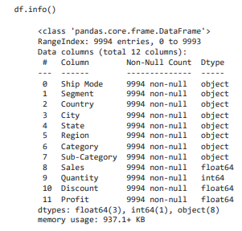
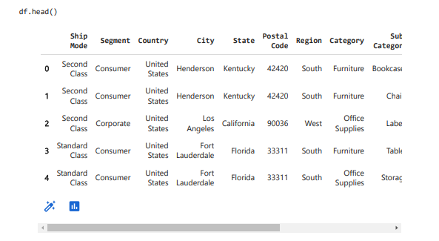
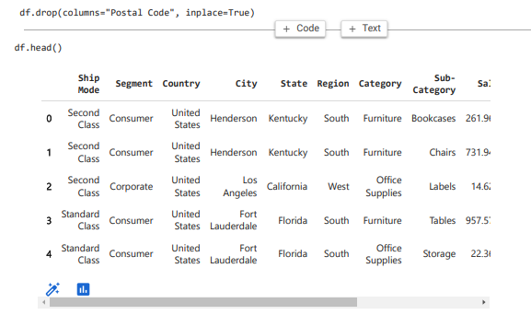
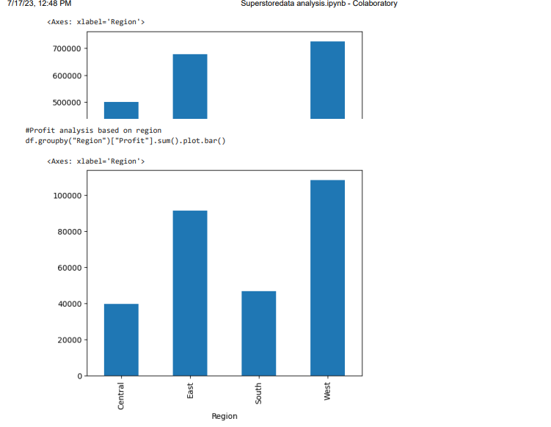
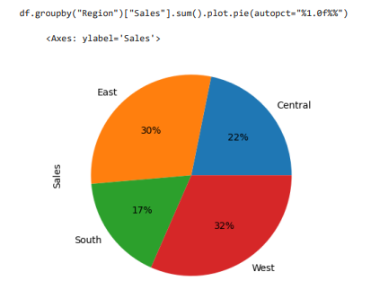
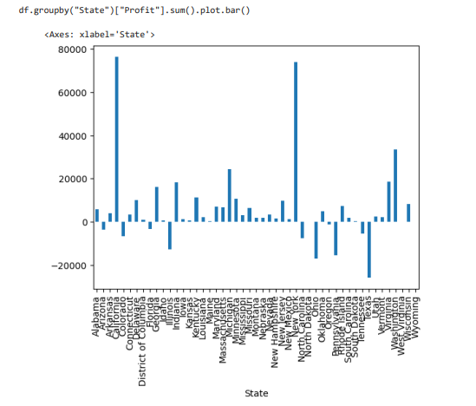
MODELLING

Slide 9
Results
From the superstore data analysis I’m able to find out various valuable insights from the dataset. The conclusions that I got from the dataset analysis are following:-
From the profit graph based on the region I came to the conclusion that the west region has the highest sale and the central region has the lowest sale. The sales percentage of the regions are following East region: 30%, Central region: 22%, South region: 17% and the West region: 32%. The profits of the following sections are following East: 32%, Central: 14%, West: 38%, South: 16% .
2. From the customer segment wise analysis I can see that The consumer section has the highest sale and the Home office segment has the lowest sale. But the Technology section has the highest profit and the office supplies section has the low profit.
3. From the state wise analysis we can see that California has the highest sale.

Slide 10
links
Here I’m attaching the link of the resources of the dataset and the project.
The csv file of the superstore dataset can be downloaded from the Kaggle website. Here is the link of the dataset.
Link:- https://www.kaggle.com/datasets/vivek468/superstore-dataset-final
Here is My github respiratory link:- https://github.com/Akash8432/Superstore-Data-Analysis
You can see my project by visiting the above link.

Slide 11
THANK YOU

